Slide 1
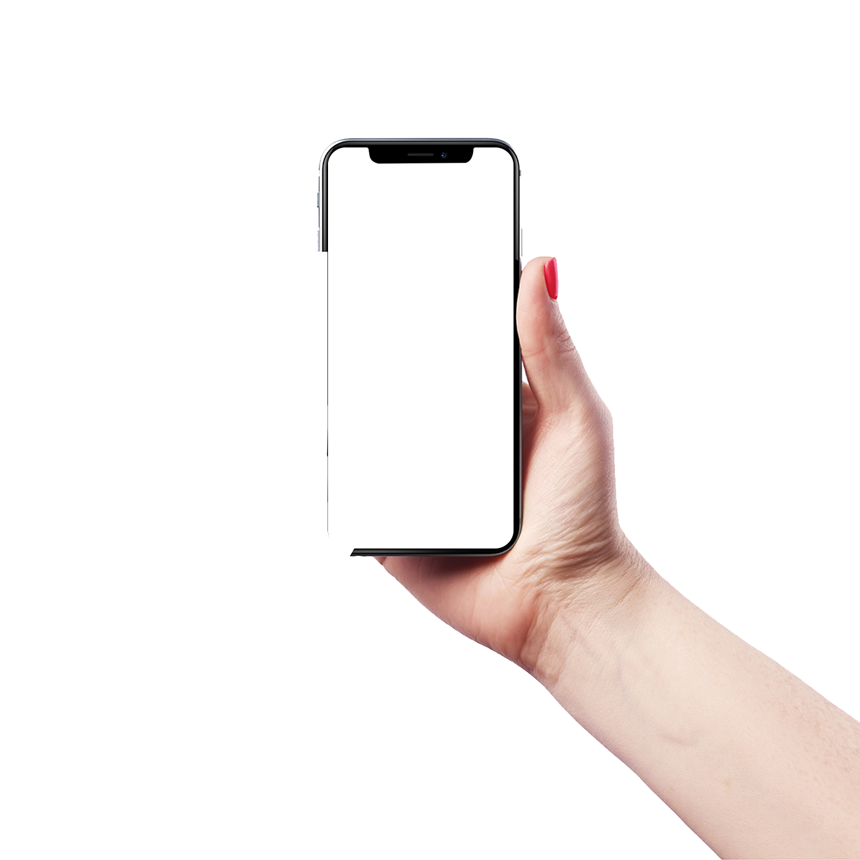
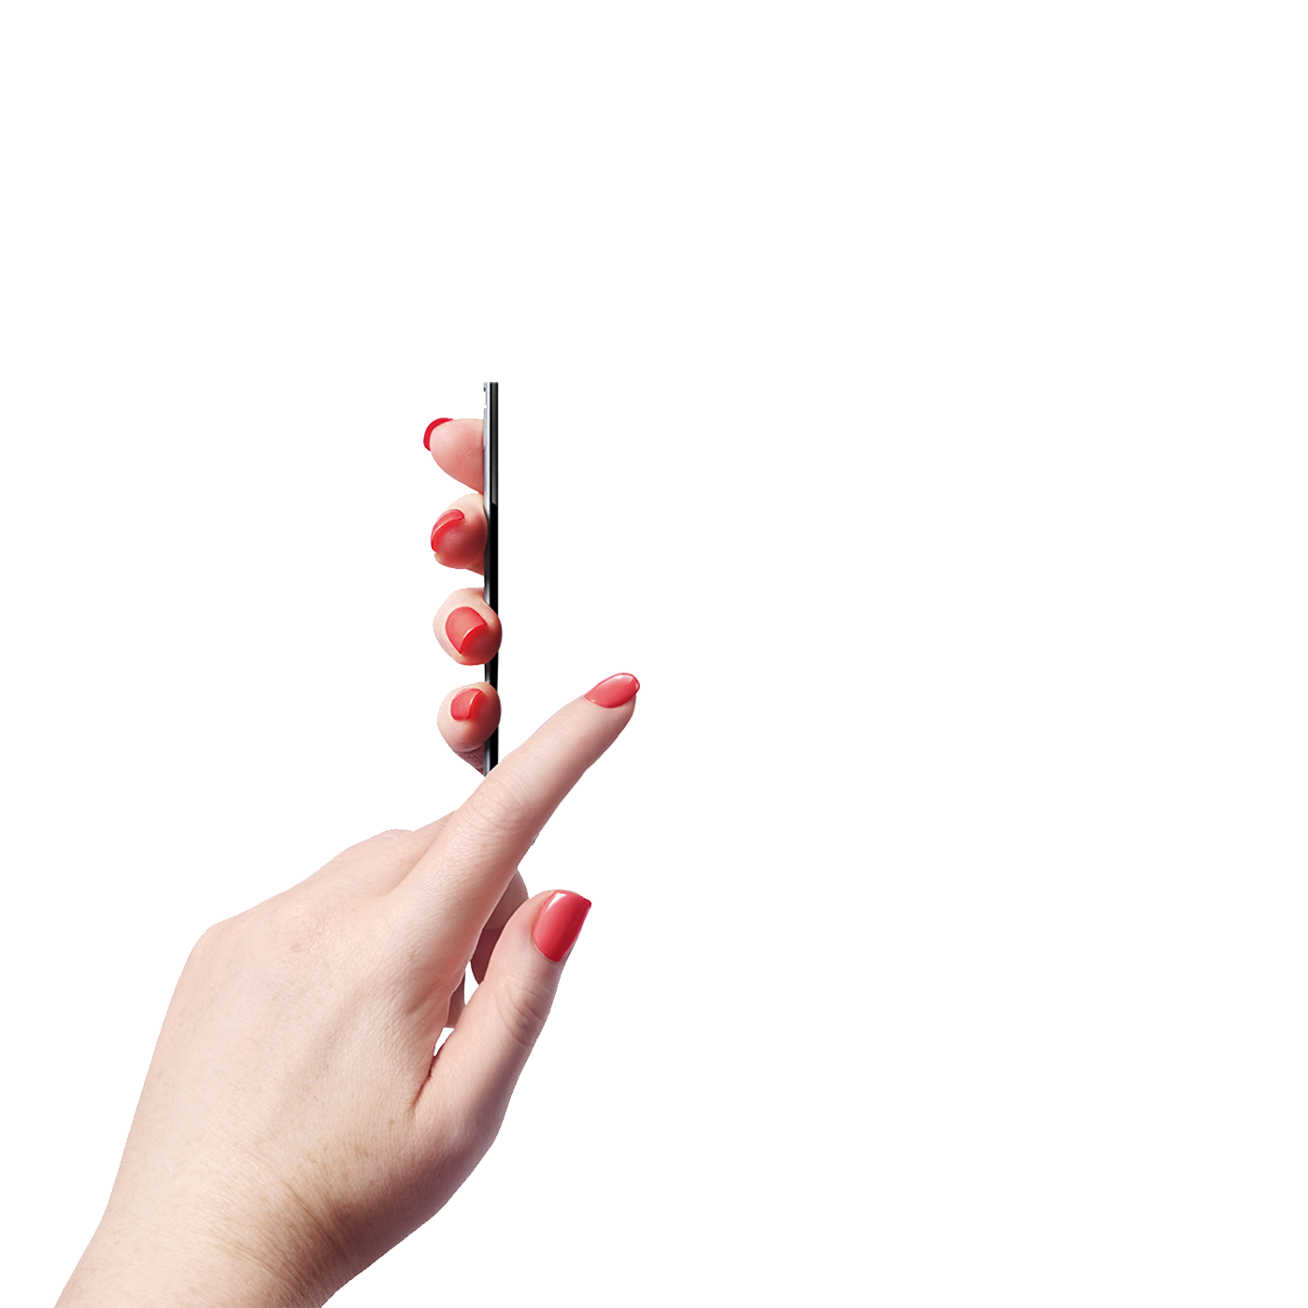

MedTronic
An IoT-based real-time telemedicine system

Slide 2
Today’s Agenda
01. About us
Meet the members
02. Motivation
Why it is important?
03. Related Work
References
04. System Diagram
How did we implement the system?
05. Prototype Development
How did we build the prototype system?
06. Different Noise and ECG Filters
How did we achieve better signals?
07. Challenges
Complexities of the proposed work
08. Conclusion
Final arrangements of our work.

Slide 3
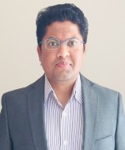

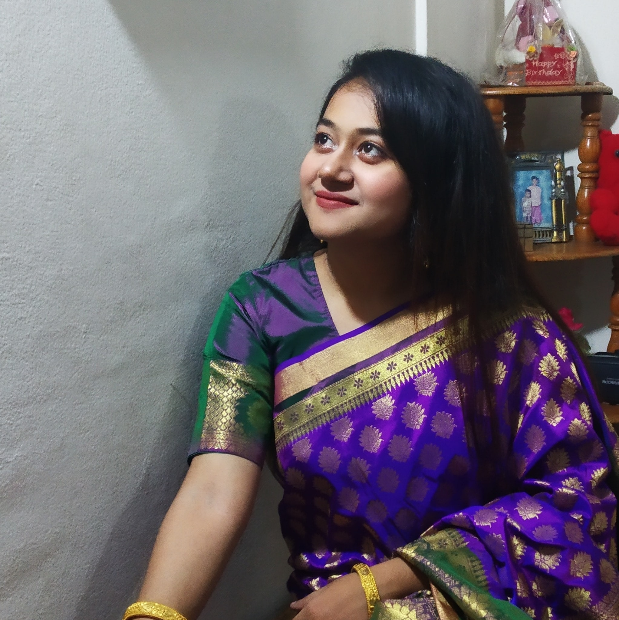
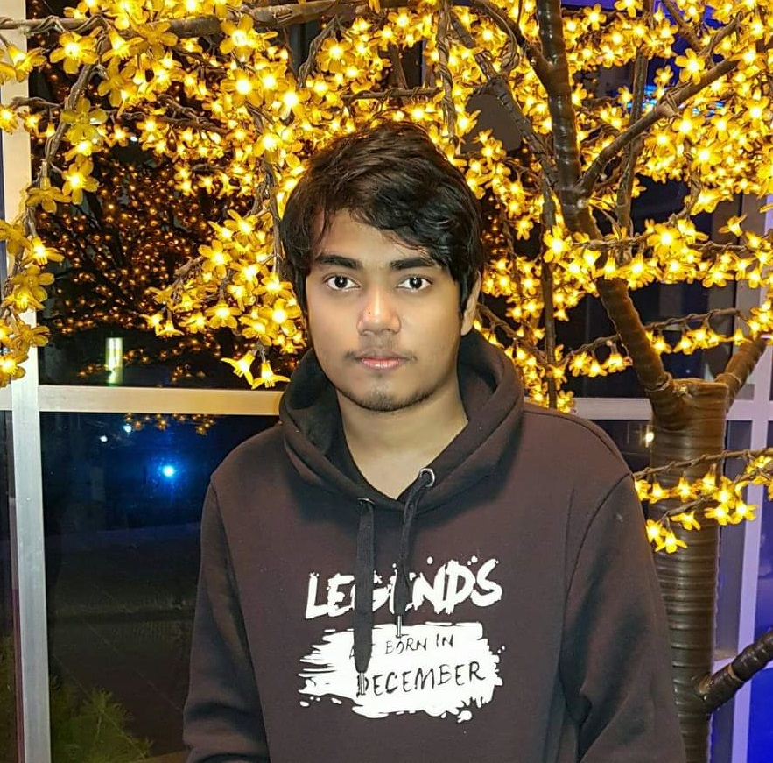
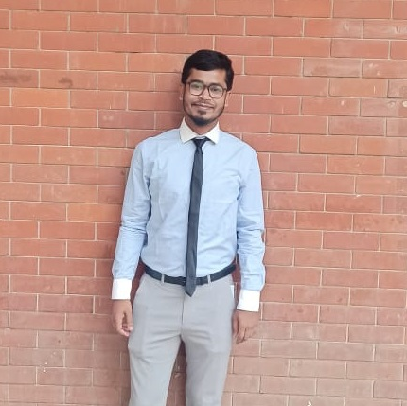
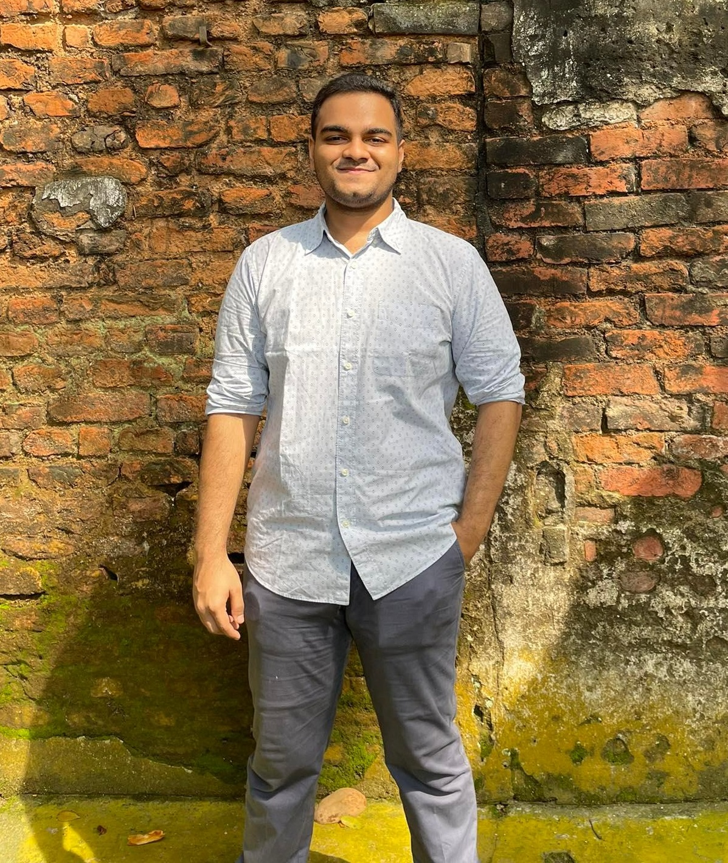
About us
Team MedTronic
Dr. Md. Raqibul Hasan Assistant Professor
Ms. Nawshin Tabassum Tanny Lecturer
Tanzela Nasrin Ahana
Muhammad Khaleduzzaman
Md. Tamzidul Islam
Md. Mubayeer
Rahman
ID: 18.02.04.012
ID: 18.01.04.102
ID: 18.01.04.123
ID: 18.01.04.144

Slide 4
Motivation
Why it is important?
Provide health care to rural and remote communities.
Provide lower-cost healthcare solutions.
Availability, and efficient sharing of medical data.
A real-time healthcare system to improve the doctor-to-patient ratio virtually.
Provide specialist doctors consultation in the villages of Bangladesh.

Slide 5
Related work
References
Uses body parameters to collect data and display it in an LCD graphical user interface.
IoT services not available.
Uses wearable and ambient sensors to track motion and vital signs.
Works in real-time but used heavy machinery and is costly.
Keeps records of patients on cloud-based networks.
Only works with ECG signal.
Shyamal Patel “A review of wearable sensors and systems with application in rehabilitation” Journal of Neuro Engineering and Rehabilitation Northeastern University.
M.Shamim Hossaina Ghulam Muhammad “Cloud-assisted Industrial Internet of Things (IIoT) – Enabled framework for health monitoring”.
U. Satija, B. Ramkumar, and M. S. Manikandan, “Real-time signal quality-aware ecg telemetry system for iot-based health care monitor- ing,” IEEE Internet of Things Journal, vol. PP, no. 99, pp. 1–1, 2017.

Slide 6
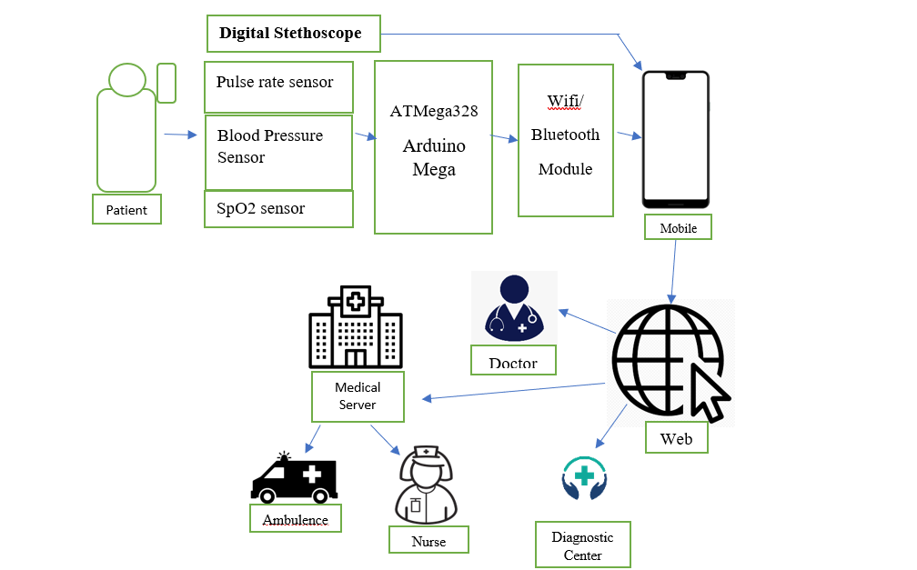
Overall System Diagram
Overall system diagram of the proposed telemedicine model

Slide 7
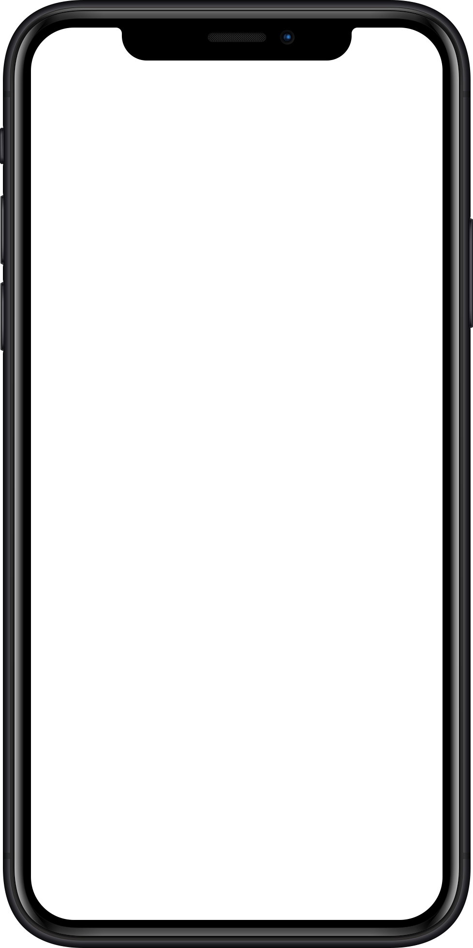
Methodology
Methods used in our project
01
Low pass filter for noise removal
02
Firebase database to store patient data
03
Arduino controlled sensors and digital stethoscope for collecting body parameters
04
Mobile app to transfer patient data
05
Filtered ECG signal

Slide 8

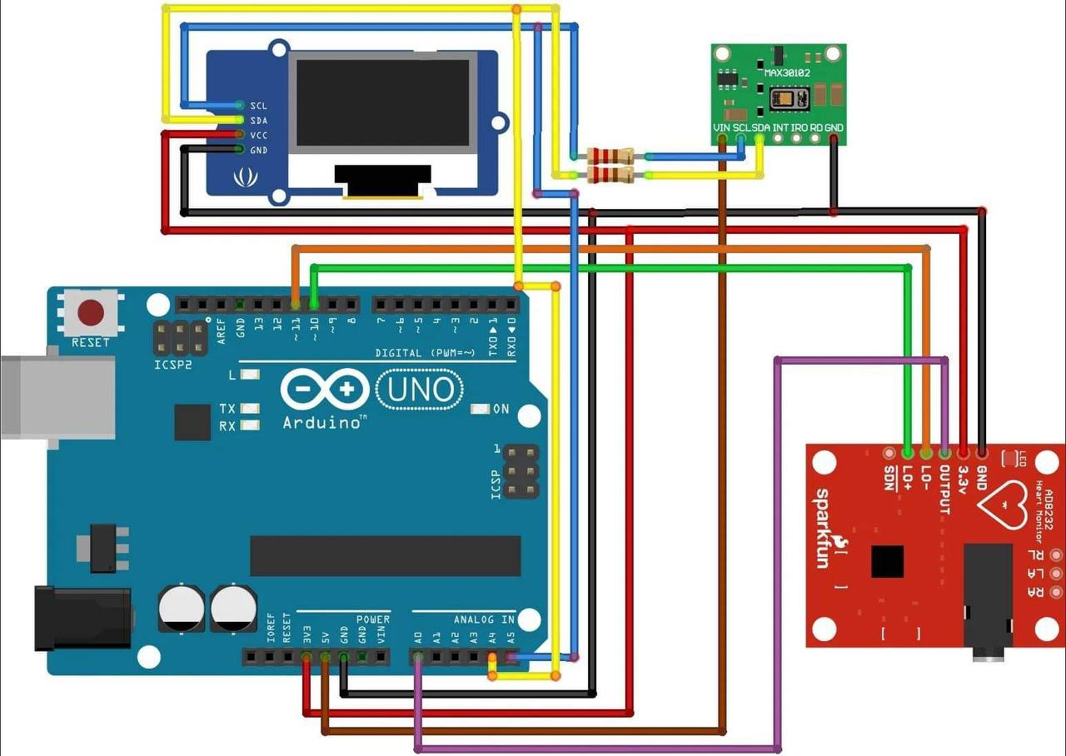
Prototype Development
Hardware Diagram
LED Display
ECG sensor
O2 Saturation Sensor
Pulse Rate Sensor

Slide 9
Hardware Components
Arduino based system
S.No. | Components | Use
01 | Arduino-Nano | Brain of the system
02 | MAX30102 | Detect Pulse Rate, SpO₂
03 | AD8232 | Detect ECG signal
04 | Li-Po Battery | Power the system

Slide 10
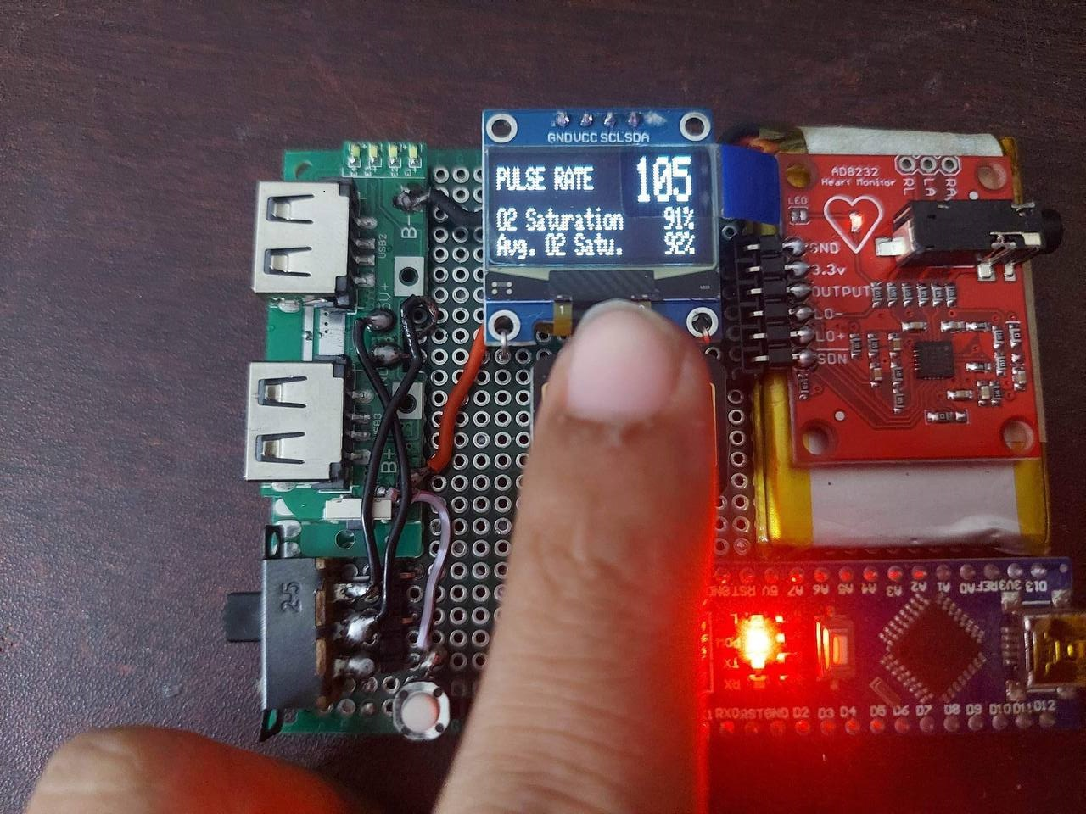
Hardware Demo
Hardware Setup

Slide 11
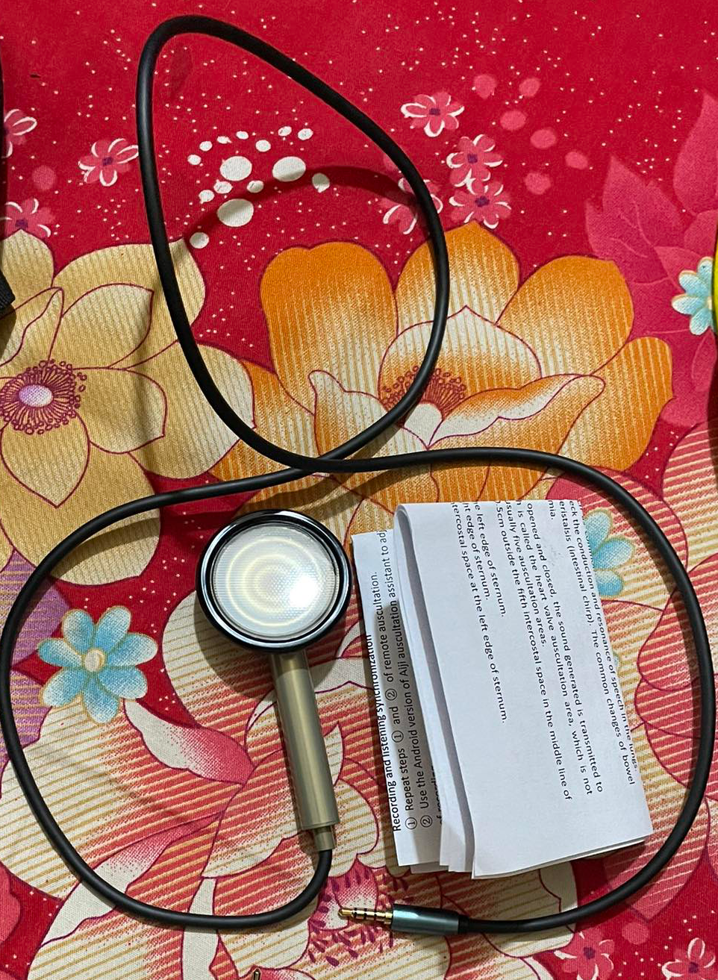
Input Device
Primary device
Digital Stethoscope

Slide 12
Signal Transfer
Transportation of stethoscope data
#2
#1
#3
Using a WiFi module in our hardware system
Direct Interfacing to mobile’s 3.5mm port
Utilizing the app to send the audio signal in real-time

Slide 13
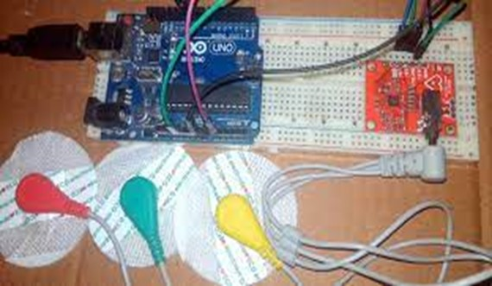
ECG Sensor & Arduino Interfacing
Records ECG signal

Slide 14
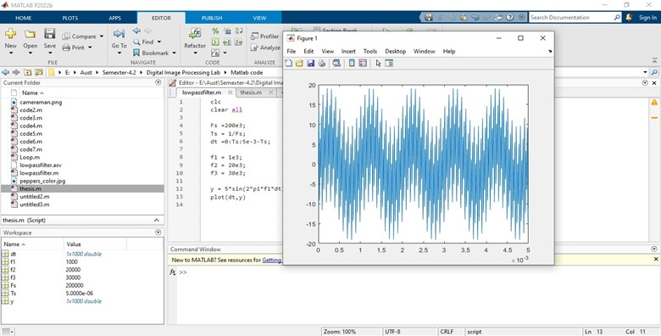
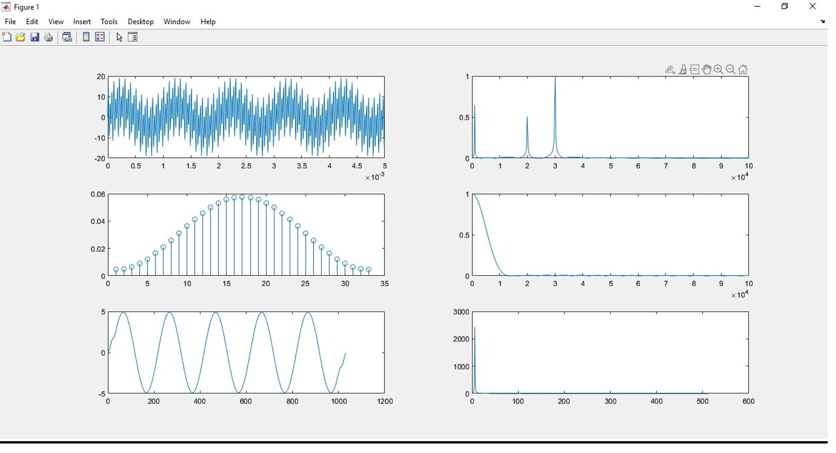
Applied Filters
Different Noise and ECG Filters to achieve better signals
Start
2. Output signal after low pass filter
Used low pass filter in our app to reduce extra noise from the stethoscope
1. Input Signal
High-frequency components of the input signal

Slide 15
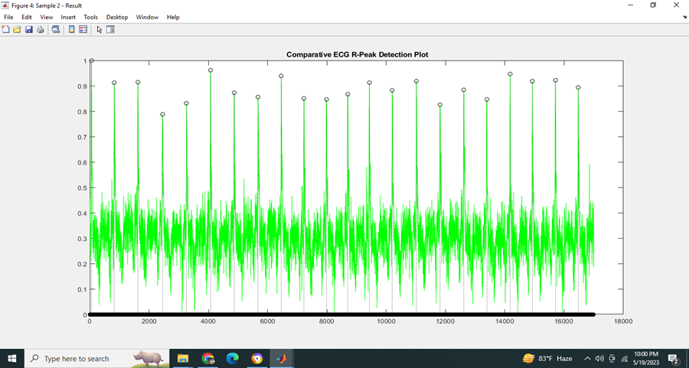
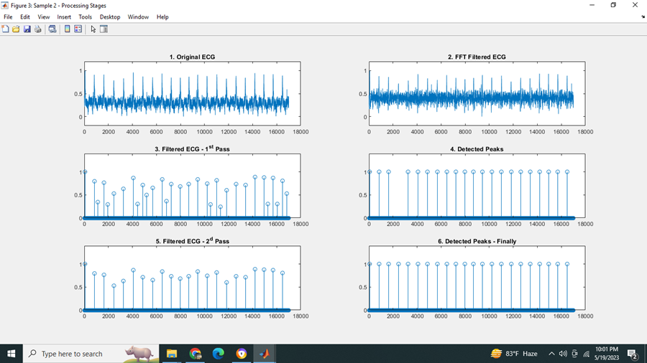
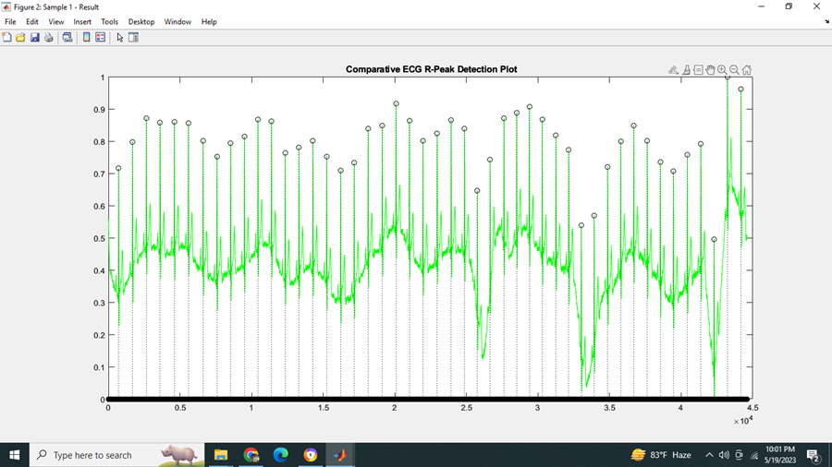
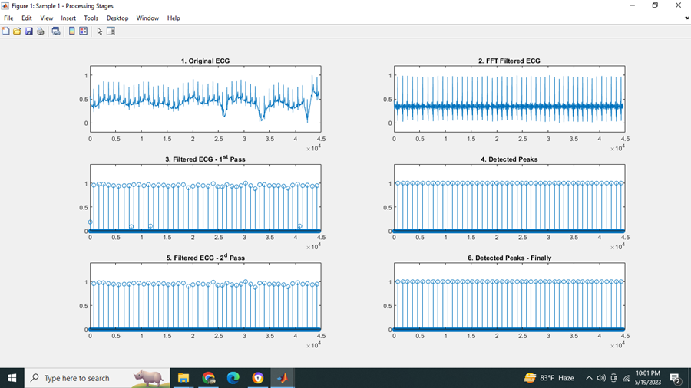
4. The original ECG
Contains noise and artifacts that can interfere with the signal.
3. Comparative ECG R-Peak Detection Plot
It represents the depolarization of the ventricles of the heart during a cardiac cycle.
6. FFT filtered ECG signal
Fast Fourier Transform (FFT) identifies signal frequency components and evaluates filtering efficacy in removing high-frequency noise.
5. Comparative ECG R-Peak Detection Plot post filtering
Used different R-peak detection algorithms and choose the one that provides the most accurate and reliable results.

Slide 16
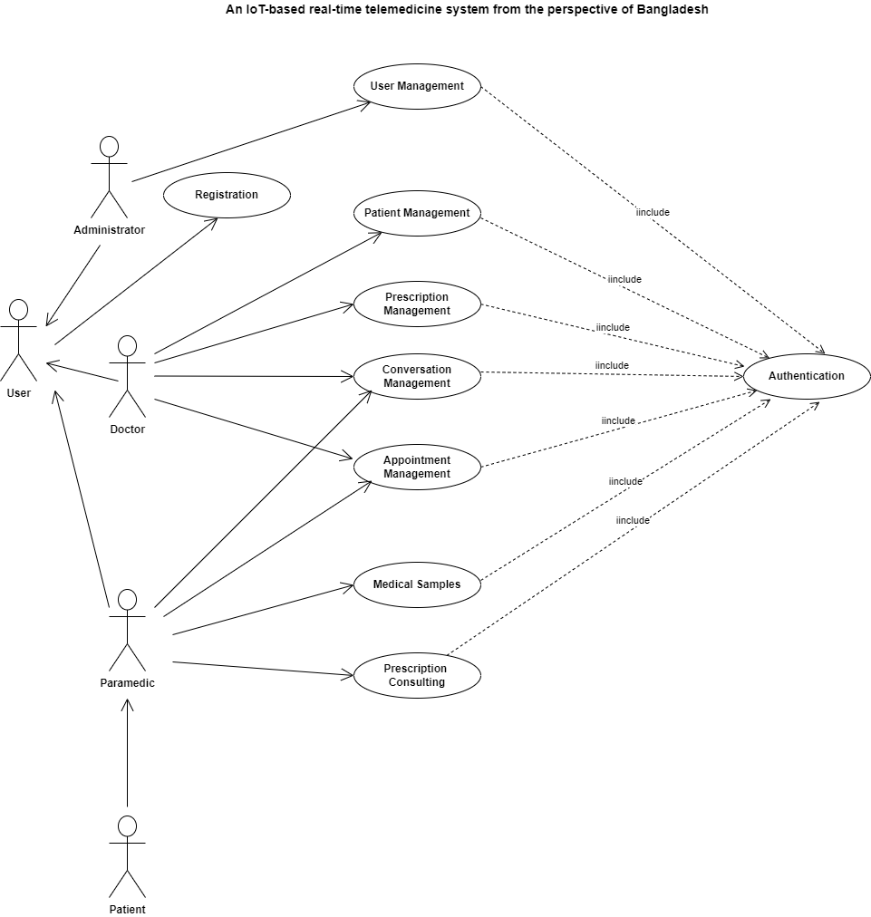
Prototype Development
Software Blueprint
5th Work experience

Slide 17
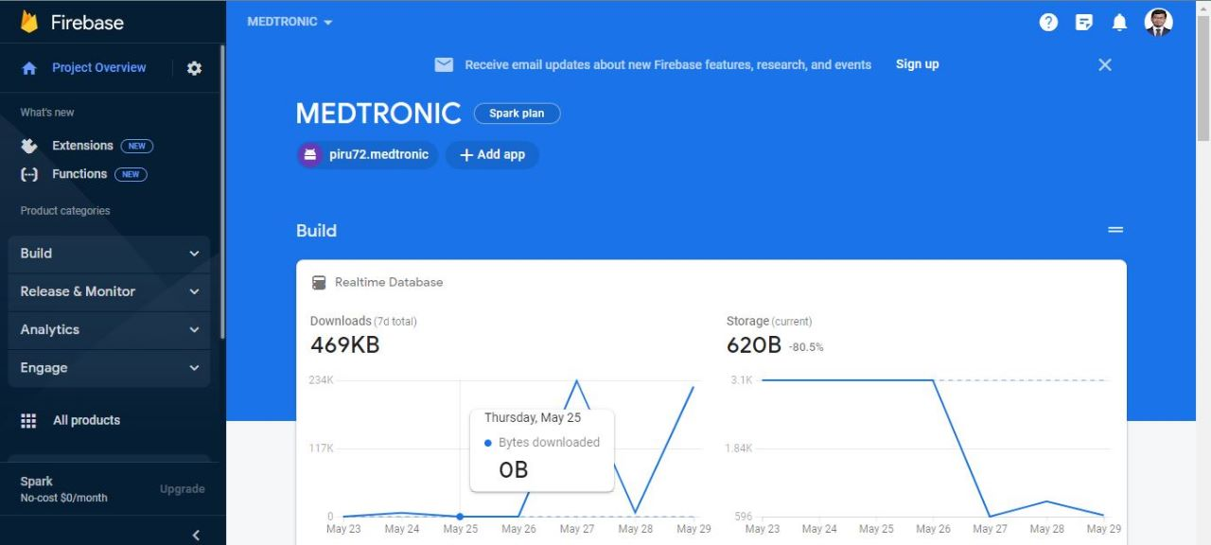
Database Management
Database access of our app

Slide 18
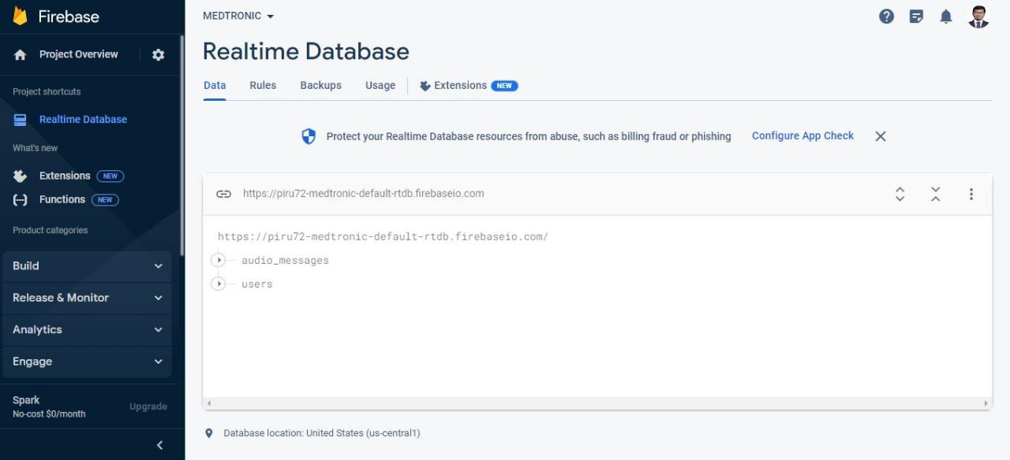
Database Management
Values that we currently store in our database

Slide 19
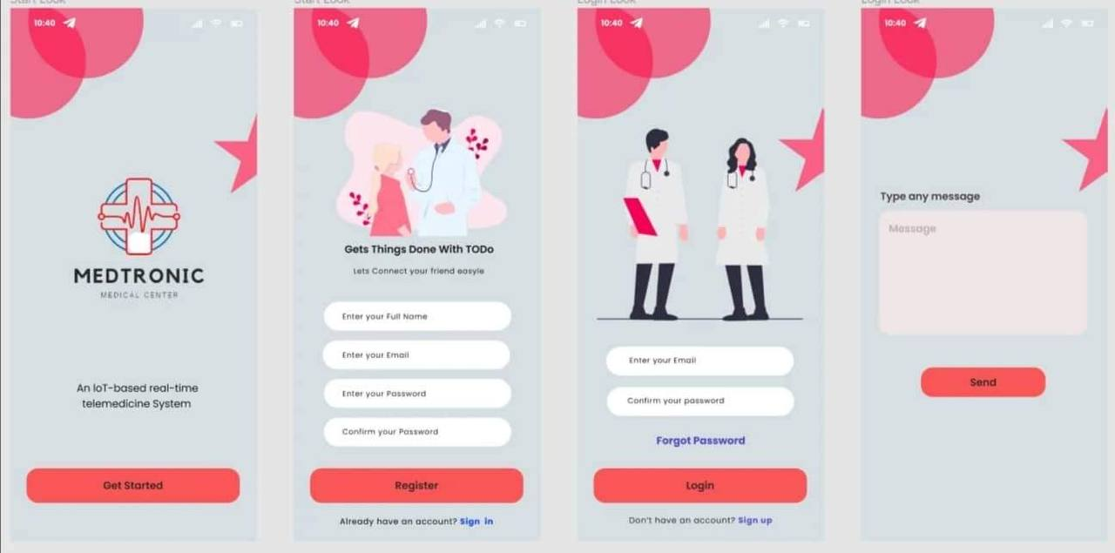
App Demo
Software Design

Slide 20
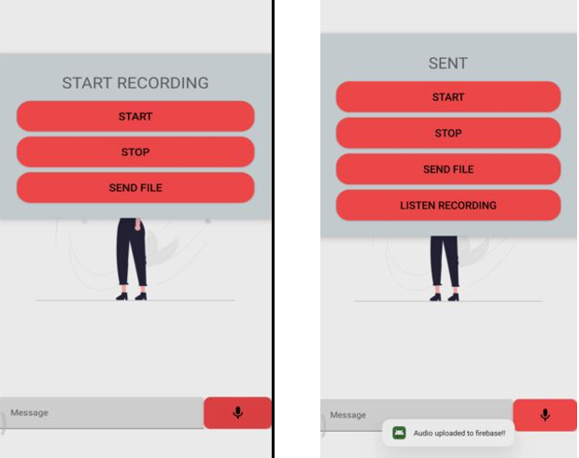
Applying low pass filter in our android app
Audio transmission system

Slide 21
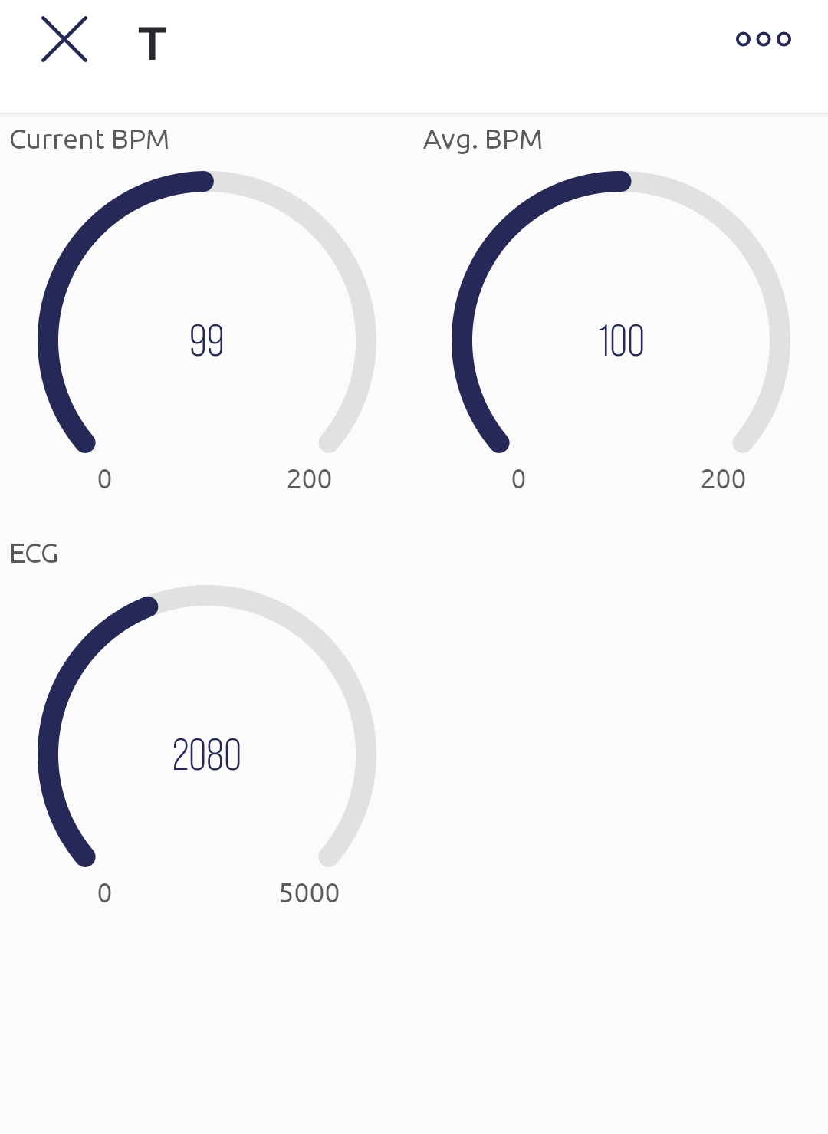
SPo2 Sensor Output in the app
Output directly from the SPo2 sensors through the database

Slide 22
Challenges
The complexities of our proposed project
Real-time transfer of heartbeat signal with noise cancellation.
Implementing filtered ECG Signals
Keeping the cost low for affordability. Reducing delay.
Making the system user-friendly and easy to operate.

Slide 23
Future Work
Forthcoming activities
Map API system to find nearby medical assistance
Implement automated first aid system using AI
Medicine Tracker
Diabetes Tracker

Slide 24
Conclusion
Efficient and low-cost medical care
Optimized noise cancelling algorithm
Easy to use app
Minimized delay in communication
Store patients’ health data
Machine Leaning for emergency alerts
Home Based Health Monitoring System Using Android Smartphone,International Journal of Electical,Electronics and Data Communication, Vol-2, Issue-2, Feb-2014, Sushama Pawar, P.W.Kulkarni

Slide 25
Any Questions?
Q
A
&
Question
Answer

Slide 26
Thank You.

